Slide 1
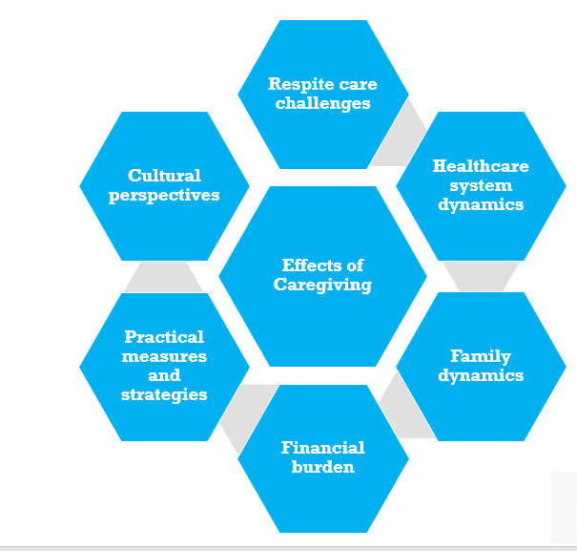
Exploring Caregiver Experiences in Providing Continence Care for Older Adults at AIC Kijabe Hospital’s Ambulatory Care: A Qualitative Study
Stella Kibet ¹, Faith Lelei ² Jonathan Nthusi ³
Introduction
Methods
Results and Implications
With increasing life expectancies, the burden of incontinence among older adults is rising. Incontinence in this population is often accompanied by comorbidity, requiring assistance with basic activities of daily living. Owing to the lack of affordable long-term care facilities, enabling environments and assistive technology in low-middle-income countries, the most significant burden is shouldered by family caregivers. Not much research in continence care for older adults has been done in low-resource settings, less so among caregivers in the community. Available evidence shows that incontinence is greatly stigmatized and invisible, presenting barriers to help-seeking in caregivers. Furthermore, there is insufficient support from primary care teams, who often overlook the problem. This research aimed to gain insight into caregivers' experiences in continence care and explore help-seeking behaviour in caring for home-based, care-dependent older adults with incontinence.
This qualitative research was conducted among caregivers of older adults with either stool, fecal or mixed incontinence, with participants obtained from the out-patient service using purposive sampling, guided by the Australian-Modified Karnofsky Performance Scale. Ethical approval was sought from ethical review committees at Kabarak University, AIC Kijabe Hospital and National Commission for Science, Technology and Innovation (NACOSTI). Focus group discussions and in-depth informant interviews using semi-structured questionnaires were done. After data collection, a thematic analysis of emerging themes was done, and conclusions were drawn.
Caregivers of older adults with incontinence suffer significant physical and psychological strain, financial burden, social isolation and impacts on personal relationships. The healthcare challenges encountered are stigma, limited support from healthcare providers, and lack of information. Support from religious communities, stronger bonds with the care recipient, reciprocity and a sense of purpose and fulfillment were perceived benefits of caregiving.
Unanticipated findings include poor working conditions for paid caregivers, that stroke had major repercussion on families, myths about STIs and their association with incontinence as well as caregivers’ apprehensive of financial burdens from unnecessary tests hinders help-seeking for incontinence. Religious communities played a key role in alleviating loneliness and offering hope to families and patients with incontinence.
Conclusion
Challenges faced by caregivers are influenced by societal expectations and personal relationships. They are physical, psychological, and financial in nature. Community-based empowerment programs and leveraging resources from religious communities will build caregiver resilience. Improving access to healthcare resources and prioritizing research on caregivers arecrucial to enhance well-being of both caregivers and their care recipients. Findings will help spread awareness of the problem and influence policy to promote continence care for older adults living with incontinence.
Objectives
1.To gain insight into the experiences in continence care by caregivers of home-based care-dependent older patients with incontinence attending AIC Kijabe’s ambulatory care
2.To understand the factors that affect caregivers’ help-seeking intention for continence care of their care recipients in managing incontinence at AIC Kijabe hospital’s ambulatory care
Contact
Stella Kibet
Kabarak University, Family Medicine and Community Health
Email:stellakibet@kabarak.ac.ke
Authors
Kabarak University, Family Medicine and Community Health
AIC Kijabe Hospital
Kabarak University, Family Medicine and Community Health

